Slide 1

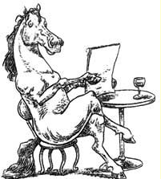
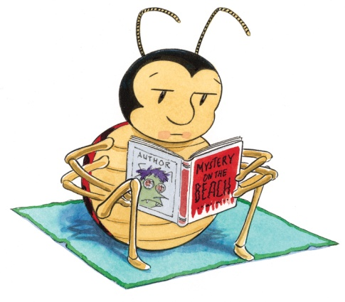

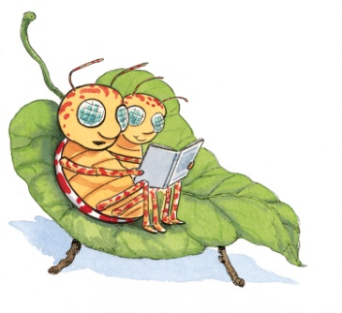

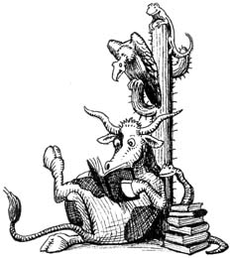
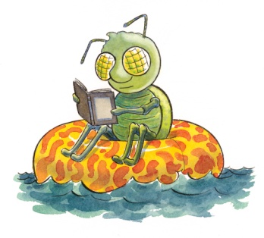

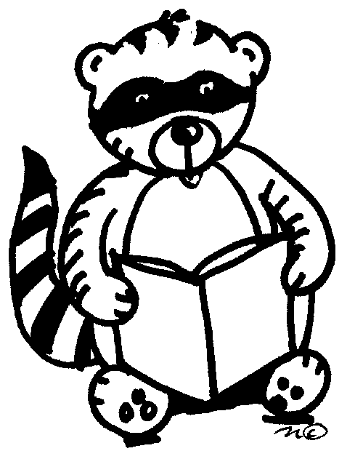
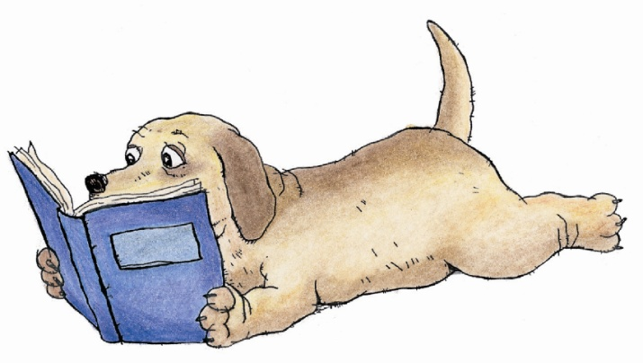
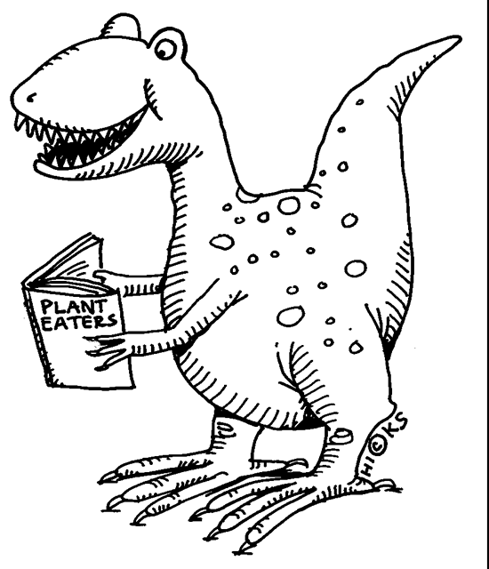
Efficient Reading

Slide 2
Bring your full attention to your reading.
Deal with distractions before reading.
Stop reading if something else is on your mind.
Do not move your lips when you read.
Do not say the words in your head when you read.
Move your eyes, not your head.
Try not to re-read.
Do not point with your hand or fingers when you read.
Do not read words that are not necessary for understanding the text.
Read a lot.

